Slide 1

Hours Domain Registration and Web Hosting
By Prof Vaibhavi Patel

Slide 2
Content
Shared Hosting:
Linux Hosting
Windows Hosting
Reseller Hosting:
Linux Reseller Hosting
Windows Reseller Hosting
Specialized Hosting:
WordPress Hosting, CMS Hosting, Ecommerce Hosting
Cloud: Cloud hosting, Cloud for business
Servers: KVM VPS Hosting, Linux Dedicated Servers, Windows Dedicated Servers
Security: Digicerts & SSL, SiteLock, CodeGuard.

Slide 3
Domain Name
Domain name is the web address of a website on the internet that identifies the website.
Whenever a person types your Domain Name, the hosting company transforms all the files connected to your IP address and returns all the images, videos, and words on your website.
Each domain name is unique as like your registered address.

Slide 4
Web Hosting
Web Hosting is a service that allows others to view your website on the Internet.
A web host offers space on their server to allow other computers worldwide to access your website via a network or modem.
Providers of web hosting services have servers, connectivity, and related web hosting services.
Types of web hosting:
Shared Hosting
Reseller Hosting
Specialized Hosting
WordPress Hosting/CMS Hosting, Ecommerce Hosting
Cloud hosting

Slide 5
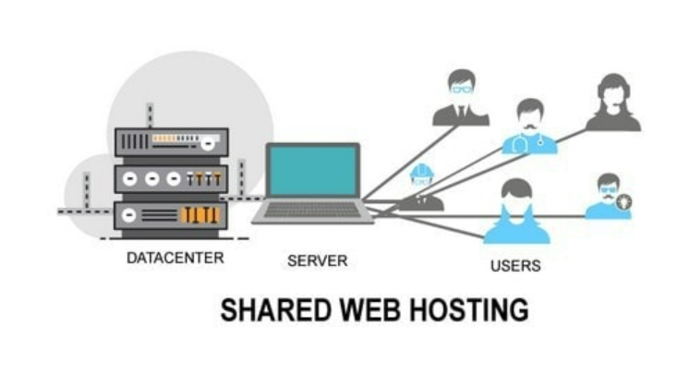
Shared Hosting
A shared web hosting service is a web hosting service where many websites reside on one web server connected to the Internet.

Slide 6
Shared Hosting
This is the most economical type of hosting as compared to other hostings such as dedicated and cloud. The cost is generally very less in this hosting type as all the resources such as CPU, RAM, memory etc. are shared by many websites simultaneously.
By choosing shared hosting, the website will share a physical server with one or more other websites.
Shared hosting is usually recommended only for small sites and sites that don’t have a very large amount of daily or monthly traffic. Also, as multiple websites share the same server so there may be sometimes security concerns.
Notes:
This hosting is very cheap also and most of the people new in blogging or in the online field start with shared hosting only

Slide 7
Shared Hosting
For business or company websites where security is important, this type of hosting is not very popular.
Due to the server is shared, system administration access is not given to the users and this is handled by the hosting company only. Now, this is a benefit for those who don’t like to deal with these things but it is a limitation for power users who like to optimize their servers according to their choices.
Though shared hostings usually have some limitations and they don’t offer a lot of features such as automatic backups, but most hosting providers offer a web-based control panel (cPanel in most cases) and with that, users get free statistics reports, email services, database access and other technical support.

Slide 8
Uses of shared hosting are
If your website does not have a lot of daily traffic or if your websites do not need a lot of resources to work.
You have a very simple and not so heavy website.
If you are on a tight budget and you need the cheapest hosting possible.
If you just need an online presence and some visibility.
And, if you want to just test some sites or if you are learning then go with shared hosting.
List of some of the best shared hosting providers
GoDaddy
Namecheap
DreamHost…

Slide 9
Shared Hosting- Linux/Windows Hosting
Almost all of the Hosting providers make an offering of two Operating Systems to host the websites on – Windows & Linux;
Linux is a free open source system; therefore, web hosting service providers do not need to pay licensing fees for using Linux as their hosting servers' operating system. Therefore, web hosting providers are able to offer lower prices for this type of web hosting service.

Slide 10
Shared Hosting- Linux/Windows Hosting
The type of hosting service you choose greatly depends on what kind of technologies your website needs. For example, if you would like to start a blog with WordPress, or setup an online forum using phpBB, then Linux hosting will be a great choice for you over windows hosting.
However, if your website requires specific Microsoft technologies such as MSSQL, MS Access, VBScript, ASP, ASP.NET, or other Microsoft based languages then you should opt for a Windows hosting plan, as these Microsoft technologies are not supported by Linux OS.

Slide 11
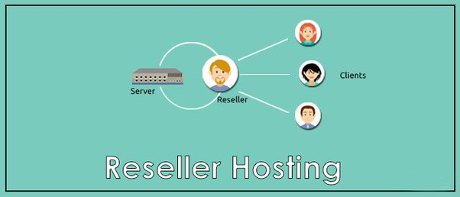
Reseller Hosting
Reseller web hosting is a web hosting solution that comprises one company/person buying hosting space and bandwidth from another company or big hosting providers who then rents out the services to third parties or small-scaled businesses.
Simply put, reseller hosting is offering all types of web hosting solutions to your own clients as if you yourself were the web hosting company.

Slide 12
Specialized Hosting
Hosting comes in a variety of different forms and specializations.
Some hosting types are named after the hardware they’re based on, while others have specialized plans with unique features.
For example WordPress hosting, CMS Hosting, Ecommerce Hosting

Slide 13
Specialized Hosting- WordPress/CMS Hosting
WordPress hosting is a service specifically offered to WordPress site owners. It comes with several WordPress-related features that you can only use if you have a WordPress site, such as pre-installed plugins etc.
Pros
Managed WordPress hosts are built to help WordPress and guarantee that they become available as quickly as possible.
They’re continuously optimized, so even as your site grows, you don’t have to worry about slowdowns.
enable users to write content without accidentally or intentionally deleting code that affects other areas of the web page.
Cons
Managed WordPress Web hosting cost more than shared Hosting because WordPress hosting handles the technical issues.
Web designers and web site owners with a technical interest may be disappointed that particular plugins are limited in access to them.
Notes:
WordPress is a content management system developed using PHP and MYSQL (which themselves are also open source in nature), used to develop a website, blogs, simpler to the most complex with ample customization options, and can be incorporated into business at a nominal cost

Slide 14
Specialized Hosting- Ecommerce Hosting
Ecommerce is known as electronic commerce.
An e-commerce web hosting can be understood as a system wherein the host company provides an organization the required online space and tools, so that it can run its retail store online.
It differs from a simple web hosting as it fulfills some additional requirements of a shopping website like SSL certificate, shopping cart, database support, payment gateways and other ecommerce security requisites.

Slide 15
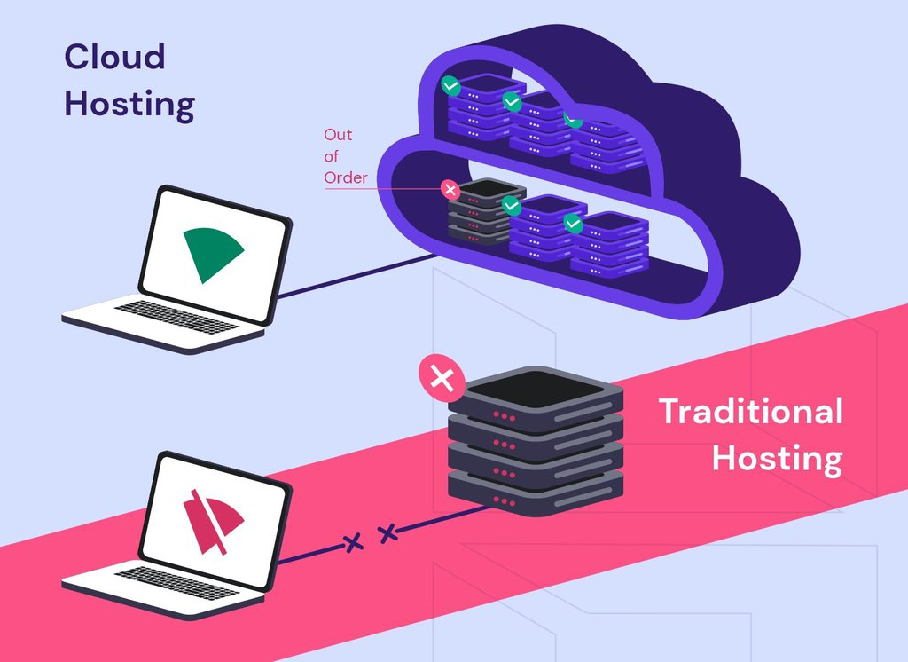
Cloud Hosting
Cloud Hosting is a type of hosting that enables a website to use the resources of multiple servers, thus resulting in a faster performance.
Notes:
Instead of hosting your website or app on a single machine, the cloud allows you to spread your data across multiple, interconnected servers, located across a wide geographical area.

Slide 16
Cloud Hosting
It makes applications and websites accessible using cloud resources. Unlike traditional hosting, solutions are not deployed on a single server. Instead, a network of connected virtual and physical cloud servers hosts the application or website, ensuring greater flexibility and scalability.
Why cloud hosting
Flexibility
Pay-as-you-go model
Reliability
Traffic load balancing
Scalability
Greater security

Slide 17
Servers
A web server is a computer that runs websites.
It's a computer program that distributes web pages as they are requested.
The basic objective of the web server is to store, process and deliver web pages to the users.
This intercommunication is done using Hypertext Transfer Protocol (HTTP).

Slide 18
Dedicated Servers
With dedicated hosting, you rent an entire physical server for your business.
If you have a high-traffic website, dedicated hosting can be the best solution for you, as dedicated servers are fast, flexible, and fully customizable.
However, the service definitely comes with a price tag as well, so they are not worth for everyone, especially if you have a small or medium website.
It allows you to configure the software as well as the hardware as per your requirement, as the entire server is yours and no one has any say in the setup.
You can also run a dedicated server on-site (for instance, in your office).
Choice of the operation system for dedicated sever can be windows or Linux.

Slide 19
VPS Servers
VPS (Virtual Private Server) is a hosting service that uses virtualization technology to provide you with dedicated (private) resources on a server with multiple users.
VPS hosting is usually chosen by website owners who have medium-level traffic that exceeds the limits of shared hosting plans but still don’t need the resources of a dedicated server.

Slide 20
Security
Web security is also known as “Cybersecurity”.
It basically means protecting a website or web application by detecting, preventing and responding to cyber threat.
Any website or application that is secure is surely backed by different types of techniques for keeping it safe.
There are a variety of security standards that must be followed at all times

Slide 21

Digicert SSL
DigiCert SSL Certificate, providing the strongest encryption available in the server security industry to Protect sensitive information.
It is the most universally recognized symbols of trust and security on the internet.
It is installed on your server so that you can provide secure/encrypt sensitive communications between your site and your customers.

Slide 22

SiteLock
SiteLock (Secure Malware Automatic Removal Tool) is a trusted security service that helps protect your site from malware and hackers.
This product performs daily scans of your website to identify vulnerabilities and protect against threats like viruses, invalid redirects, and even email blacklisting.

Slide 23

Code Guard
CodeGuard is an automated website backup tool.
Every website is vulnerable to malicious attacks and risk of losing all the files. Besides having a good website protection service you will need to get a back up service that will work like an insurance policy every time something wrong happens to your website
It stores the backup data on the third-party cloud platform and features a one-click restore function. It uses a 256-bit AES key to encrypt the backup files.
It also continually monitors website and saves all the changes made.
You choose how long you keep your backup history. By default, your site is saved for 90 days.

Slide 24
Thank You

